Slide 1


Slide 2


Deep Linking and Semantic Data
__
Phillip Nelson
Director of Product, Search
@phillipnelson
proprietary & confidential
Notes:
Hello! My name is Phillip Nelson. I'm a director of product at Quixey, where I lead the product team responsible for our core search engine for native mobile apps.
Our mission is to help users find the best apps, and app developers to find users.
We are going to discuss mobile deep linking and structured and linked data, a combination of complimentary technologies we and other search products use to search apps.

Slide 3
Deep Linking helps other apps identify and direct users to particular states of your App.
Semantic Data helps search engines and other products know more about your content, how to present it and when it’s relevant to their users.
The Value Proposition
Describe Content and
App Behavior for Search

Slide 4
In combination, semantic data and mobile deep linking facilitates content acquisition, which enables users to discover and engage with your apps more easily and more often.
The Value Proposition
Describe Content and
App Behavior for Search

Slide 5
Deep Linking
What are deep links?
Why are deep links useful for developers? For users?
How do I implement deep linking?

Slide 6
Web Deep Linking
http://example.com/over/there?param=value
Notes:
Conceptually, understanding deep linking on the web will give us a good baseline and common language to describe native mobile deep linking.
Here's an example URL from the web that we all know and love.

Slide 7
Web Deep Linking
http://example.com/over/there?param=value
scheme
domain
path
query
Notes:
This URL has a few different parts.
The scheme indicates HTTP, the protocol for the web.
The domain, example.com, designates the host that your browser will connect to.
The path specifies the document from the host the browser is requesting.
And finally the query which is additional data passed to the server.

Slide 8
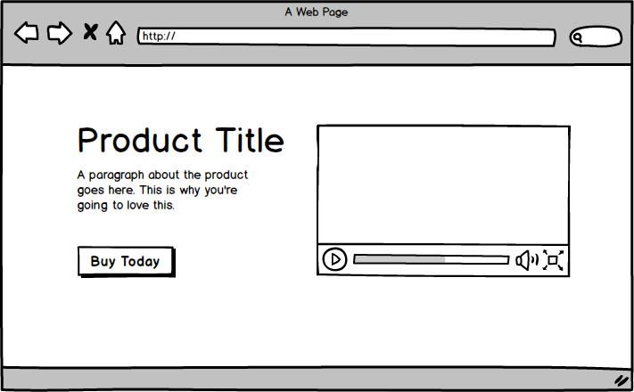
Web Deep Linking
http://example.com/over/there?param=value
path + query ~= document
Notes:
This is a deep link, because the path and query should map to a specific web page on the host.
The capability of the web to deep link is built-in at the protocol level because it's important that users can link to other web pages and browsers can request specific documents.
For example: when you search for a restaurant on a search engine and navigate to a result, the engine has indexed that particular document, and the browser should request the deep link URL to show you this particular document.

Slide 9
Web Deep Linking
http://example.com/over/there?param=value
index
document
Notes:
Imagine that search engines could not link you directly to the correct web page, and instead, could only link to you the home page for the domain.
You would have to navigate through the UI in the web application to eventually reach the correct web page.
Let's start to draw some parallels from this to the native mobile user experience.

Slide 10
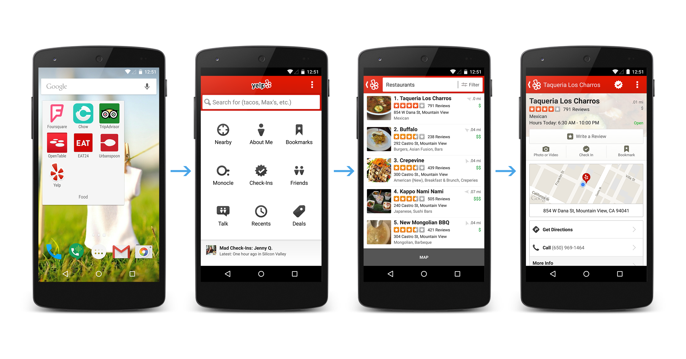
Mobile Deep Linking
Notes:
Today, when users need to open a particular part of an app, we open the application from some sort of launcher experience.
In my android device, I open a Folder, and tap on the Yelp icon.
Then from the main activity of the app, I navigate through the UI to reach the part we need.
I tap on nearby, scroll through a set of restaurants nearby, and then find the restaurant I need.

Slide 11
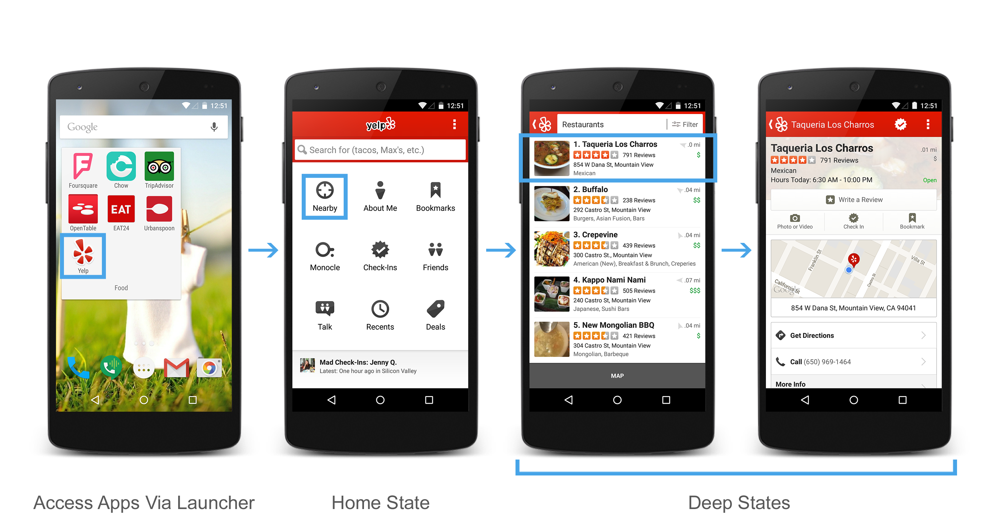
Mobile Deep Linking
Notes:
If we were to compare this experience to the web, it's as if the home page of a website were the only starting point for interacting with the web.
It’s ridiculous, but this is sort of how most people use their devices.
When describing parts of apps, we should consider them as discrete states of the app.
Deep states are states of an application other than the home state (Main Activity) that a user can navigate to.
Linking to deep states is what native deep linking is all about.

Slide 12
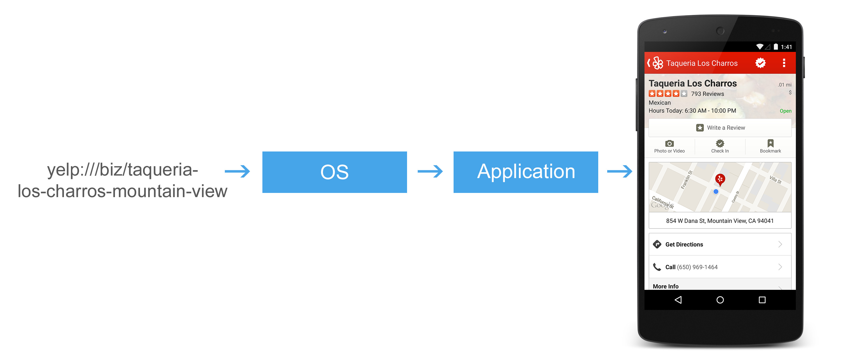
Mobile Deep Linking
Notes:
To be very precise, a Deep Link is a URI that a mobile operating system and an app can interpret to open a particular state of an app.
On Android, this is built on top of the intent system.

Slide 13
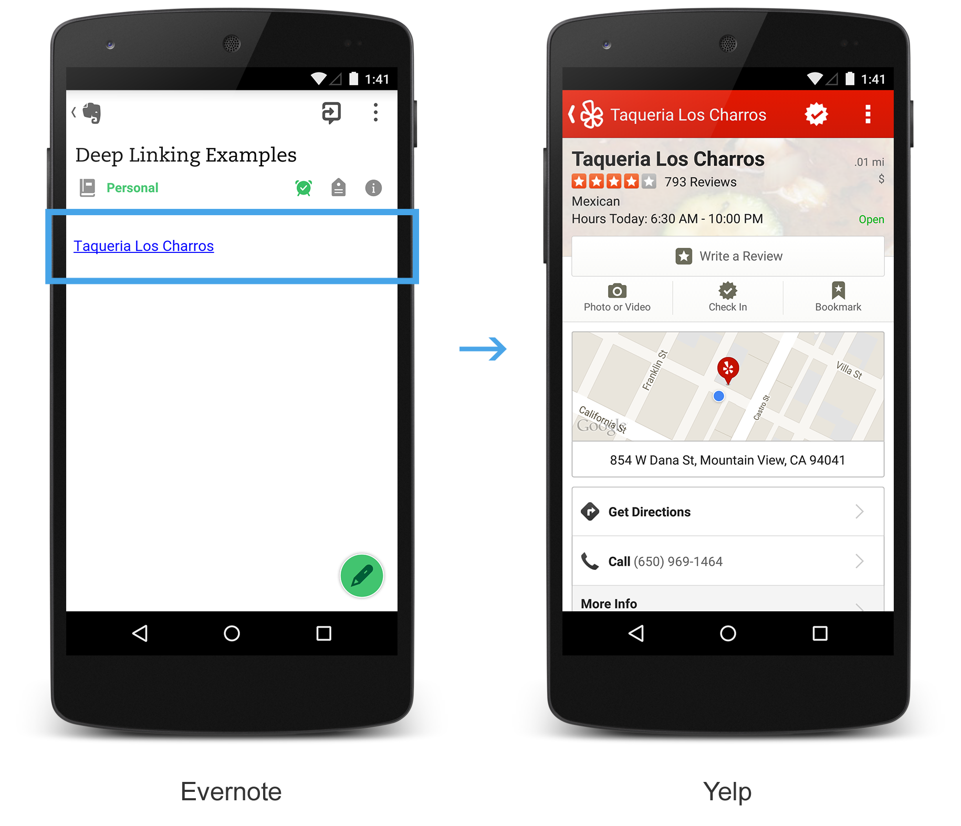
Value Prop
Improved User Experience
Quickly navigate to commonly used features
proprietary & confidential
Notes:
Let's start with users.
We know from the web that bookmarking and search engines allow users to quickly navigate to commonly used features.
I like to save links in evernote. When I tap on a link in evernote on my android device, Yelp's native android app opens. This is way more convenient than opening the deep link on the web, because my android yelp app has additional features and my user state.

Slide 14
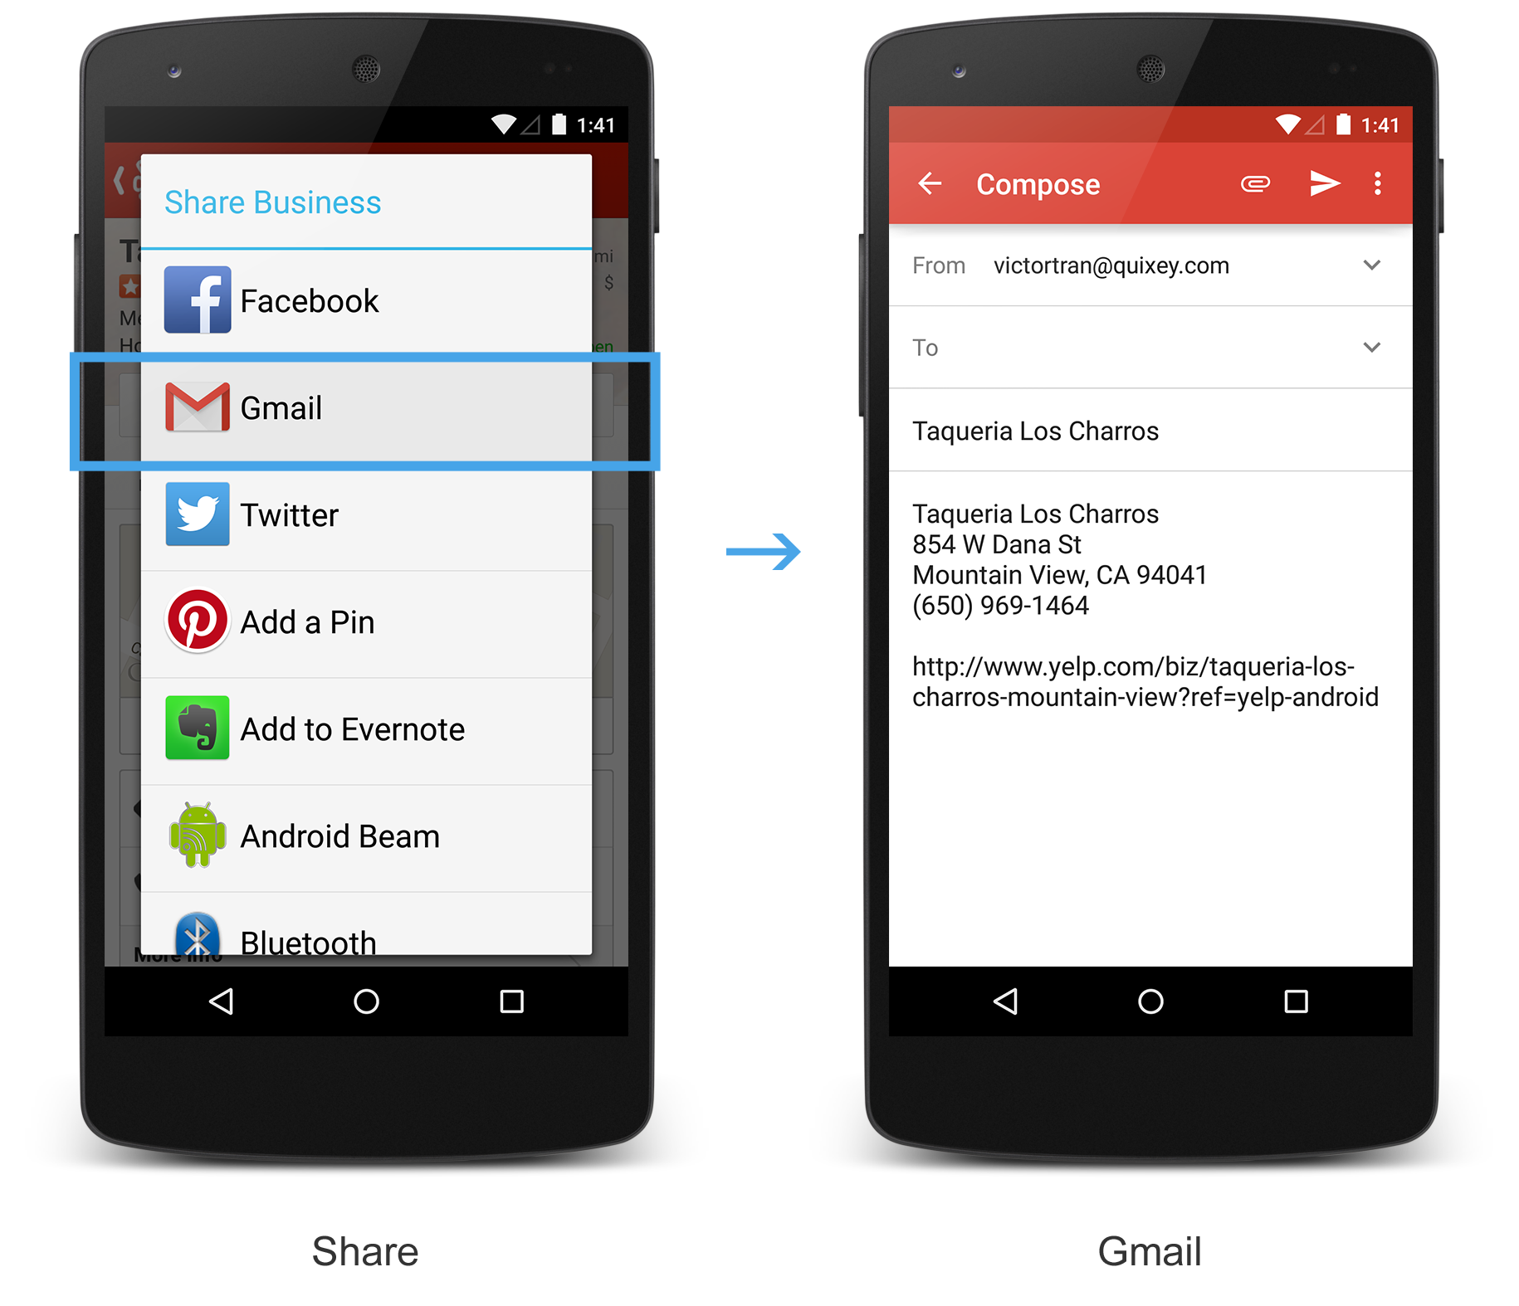
Value Prop
Improved User Experience
Share particular features or states with other users
proprietary & confidential
Notes:
2. Users like to share particular documents or states with other users.
From yelp, tapping on the share button in the native app yields a deep link that is usable both in the web and in the native app environments.

Slide 15
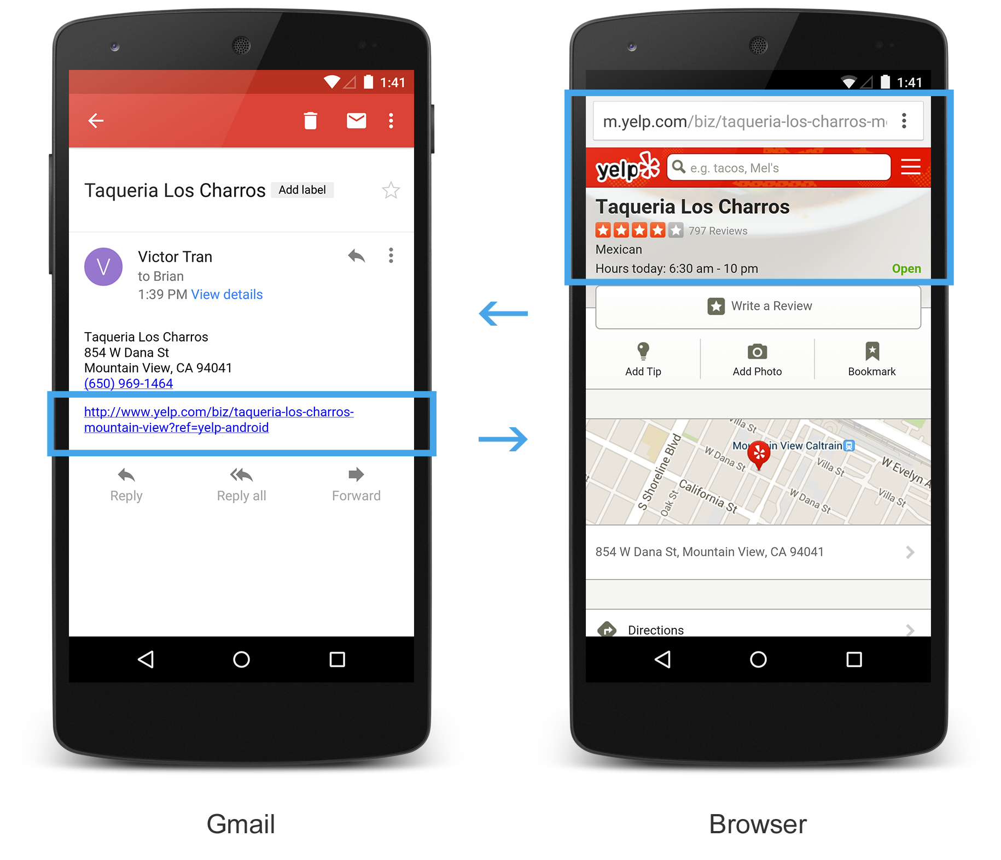
Value Prop
Improved User Experience
Android: "Back" capabilities make inter-app navigation more useful
proprietary & confidential
Notes:
In the web, when one website links to another, they do so knowing that users navigating away are able to easily go back to the previous page.
3. Back capabilities make inter-app navigation more useful.
This is a great feature in iOS. I've shared the link. I don't have yelp installed, so it opens the link in Safari. The back button is labeled Gmail takes me to the previous deep state in the gmail app.
When we’re fighting for users, linking users outside of our owns Apps can be very painful, yet sometimes it’s the best things for the users, and good for you in the long run. Linking between applications is key to improving the mobile user experience.

Slide 16
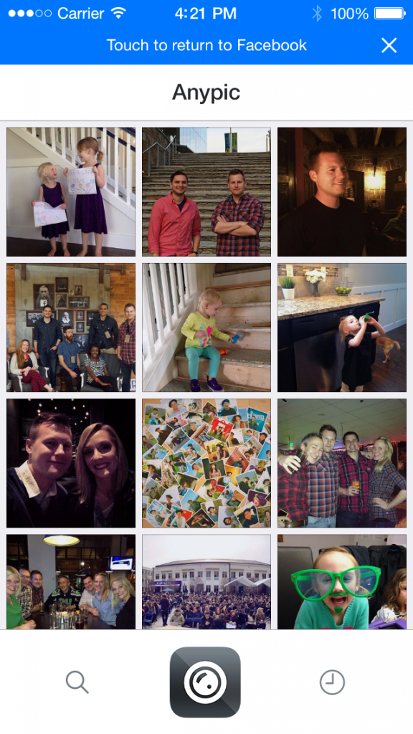
Example
Improved User Experience
A Facebook SDK feature on iOS powered by App Links returns users to the previous state by tapping on the header
proprietary & confidential
Notes:
Another example I like: On the right I have a Facebook SDK feature on iOS powered by App Links that allows me to return to the previous state by tapping on the header.

Slide 17
How: Mobile Deep Linking Works
Defining
Publishing
Web to Native Mappings
Stand-alone Native
Navigating
Notes:
Let's go through strategies for implementing Deep Linking
How do we define links so that users can open particular states directly?
How do we publish links so that users and third-party services can direct users to the best state?
When we encounter a link in our own application, or want to direct users from the web to native, how do we navigate users to a native deep link?

Slide 18
How: Defining Deep Links
Android
Define intent filters in the app manifest
Should have at least one intent filter per deeplinkable activity
The intent filter should have a data tag with at least the android:scheme attribute set
Handling the intent in the activity
Notes:
On Android, it’s a simple configuration in the manifest. Ad you need to handle the intent in the activity.

Slide 19
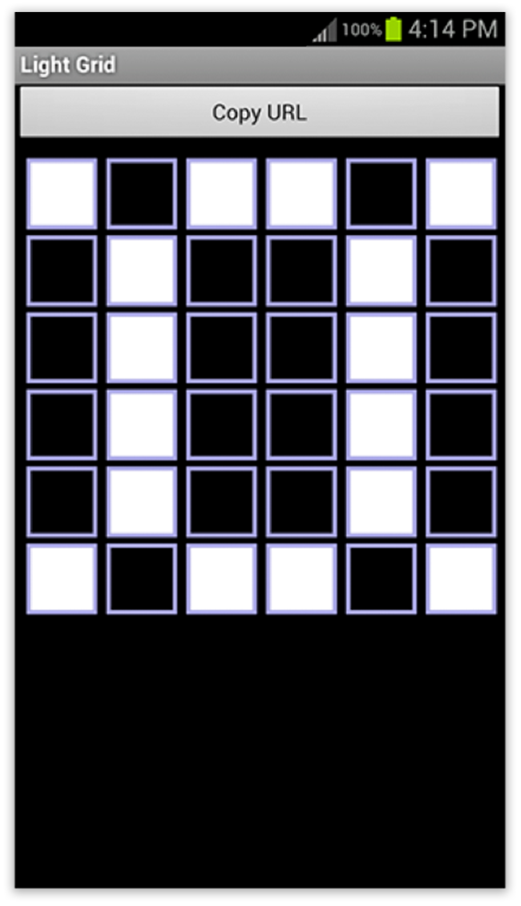
Example: Grid6
Make 6x6 pixel art to share with friends
Notes:
Let's jump into a real-life example, Grid6
In this app, users make simple 6x6 pixel art to share with friends

Slide 20
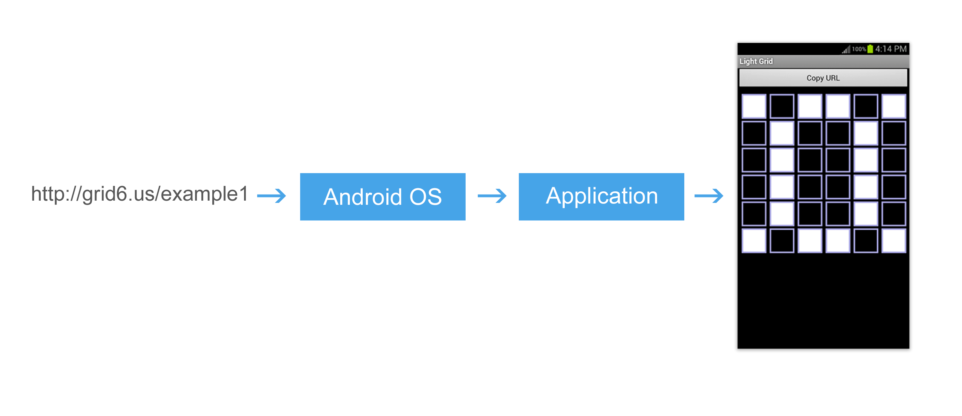
Example: Grid6
Notes:
When a particular piece is shared, a unique slug is generated
Each deep link can open a particular state in an app

Slide 21
How: Intent Filters
<activity xmlns:android="http://schemas.android.com/apk/res/android"
android:name="us.grid6.HandleURL"
android:label="Grid6”>
<intent-filter>
<action android:name="android.intent.action.VIEW" />
<category android:name="android.intent.category.DEFAULT" />
<category android:name="android.intent.category.BROWSABLE" />
<data android:scheme=“http” android:host=“grid6.us” />
</intent-filter>
</activity>
Notes:
Let’s document the intent filter

Slide 22
How: Handling Intent
@Override
public void onCreate(Bundle savedInstanceState) {
super.onCreate(savedInstanceState);
setContentView(R.layout.main);
Intent intent = getIntent();
Uri data = intent.getData();
String path = data.getPath();
// Url “http://grid6.us/example1”: Path object now is equal to “example1”
}
Notes:
This is the java code in the activity’s onCreate function that extracts the slug, example1, from the deep link.
And then you would have your actual application logic to actually render what you need.

Slide 23
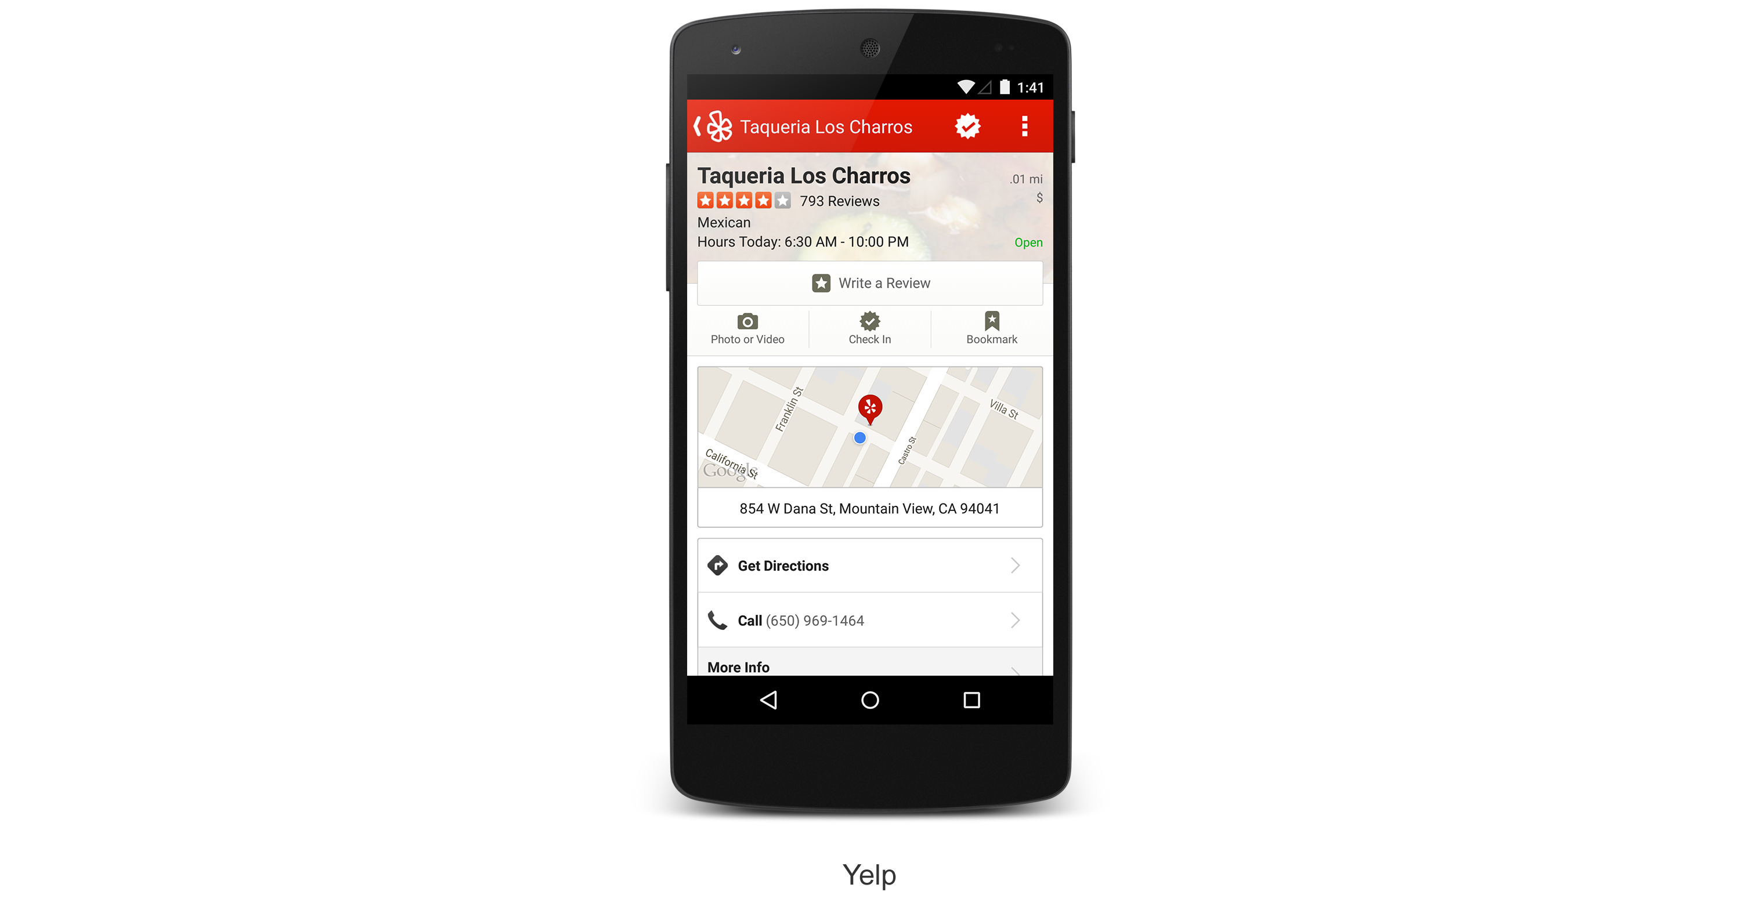
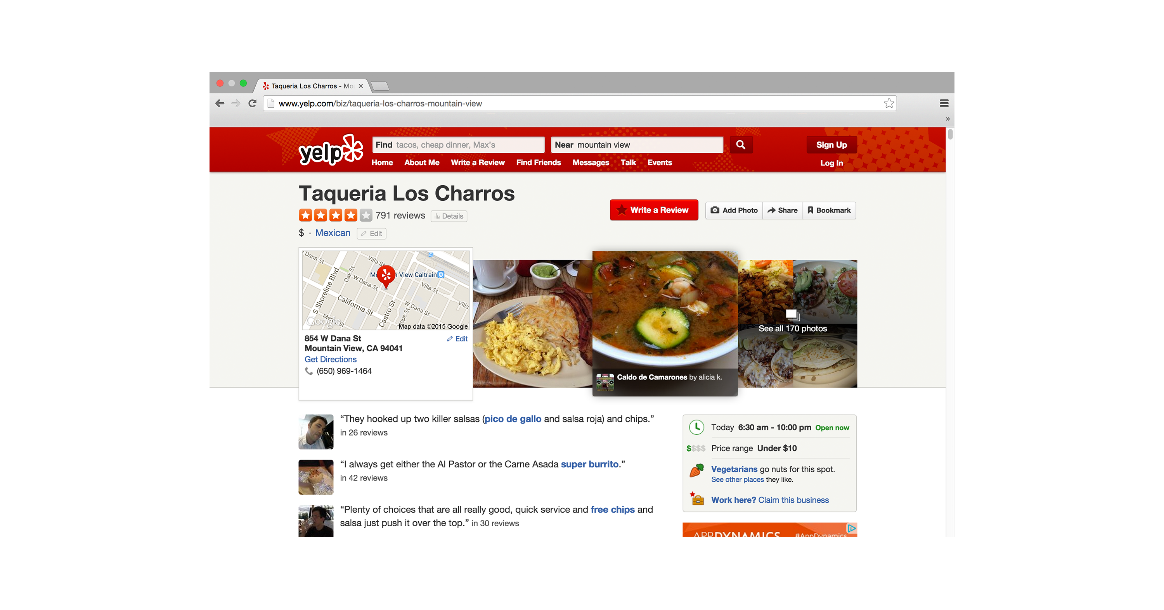

Publishing: Web to Native Mappings
proprietary & confidential
Notes:
We want to publish links so that other apps can take advantage of the deep linking capabilities.
For developers with web content, the process of publishing deep links is simple.
For a given document on the web, define a Deep Link for the corresponding page in one or more native platforms.

Slide 24
Publishing: Web to Native Mappings
HTML
meta tags
Facebook's AppLinks, Twitter's Card Specification
link tags
Google's App Indexing
Site Map xhtml:link tags
Google's App Indexing
AppURL’s Sitemap Protocol
Ad campaigns to re-engage customers can be optimized.
proprietary & confidential
Notes:
Publishing depends on the standard for communicating the existence of deep links to others.
Facebook's AppLinks and Twitter's Card specification both rely on META tags in the dom.
Google's App Indexing spec utilizes LINK tags, either in the dom, or as a property in the sitemap.

Slide 25
Publishing: Web to Native Mappings
<?xml version="1.0" encoding="UTF-8" ?>
<urlset xmlns="http://www.sitemaps.org/schemas/sitemap/0.9"
xmlns:xhtml="http://www.w3.org/1999/xhtml">
<url>
<loc>http://grid6.us/example1</loc>
<xhtml:link rel="alternate" href=”android-app://us.grid6/http/grid6.us/example1" />
</url>
</urlset>
Notes:
This is an example of the site-map implementing the app indexing standard for the Grid6 app.

Slide 26
Publishing: Stand-Alone Native
Publish Directly
App Indexing API (Google)
Publish new Deep Link URIs (web urls optional) to Google Service during client run-time.
App Links Host to Index API (Facebook)
Data about App Links URLs is available through this Graph API
Endpoint to publish App Links edges
Notes:
Some developers do not have web applications. How do we publish deep links in these cases?
Well, of course you can still publish links directly, as in the case of sharing content from user to user or on social media.
In general, to take advantage of the linking standards, the current implementation is to publish URLs to directory services.
App Indexing API is published by Android Apps during run-time.
App Links has a Host endpoint to the Index API, part of the Facebook Graph, where developers can publish App Links edges that Facebook will use to resolve URLs.

Slide 27
How: Navigation
Open URL directly through OS as Intent
Resolve URL through SDK
E,g, Index API (Facebook SDK)
3rd Party Deferred through the web
E.g. Web Javascript
proprietary & confidential
Notes:
Handling deep link navigation is important for growth so that you understand how 3rd parties are opening your links, and how you handle your own fallback and deferred systems.
The most simple implementation is to open all URLs utilizing the built-in URL resolution system.
If the native URL is the same as the web url, or if the native app is able to handle the web urls, this system works well.
If this is not the case, we can use a resolution service to introspect to see if the URL has a registered deep link in the client platform.
Another option is to open the web application, and then use javascript or a third party service to open the corresponding service.

Slide 28
How: Triggering Intent
// ... snippet
String url = "http://grid6.us/example1";
Intent i = new Intent(Intent.ACTION_VIEW);
i.setData(Uri.parse(url));
startActivity(i);

Slide 29
Deep Linking
Deep Linking helps other apps identify and direct users to particular states of your App
Define the deep link
Publish the link information so other apps know about it
Users can Navigate to the deep state
How does semantic data expand on these capabilities?

Slide 30
Semantic Data (Value Proposition)
Deep link publishing standards utilize some structured and linked data to describe additional information about the deep state:
Content Modeling
Presentation
Relevance

Slide 31
Content Modeling
The more developers can express about models, the easier it is for content consumers to programmatically categorize and organize content from your apps.
Types
Properties or fields
Relationships with other objects

Slide 32
Modeling Requires Ontology
Machine-readable naming of types, properties and interrelationships.
Schema.org
Open Graph protocol
Simplified ontologies are sometimes called vocabularies or schemas.
Notes:
In computer science and information science, an ontology is a formal naming and definition of the types, properties, and interrelationships of the entities that really or fundamentally exist for a particular domain of discourse. It is thus a practical application of philosophical ontology, with a taxonomy.
This is not a complete list of popular ontologies. We will be focusing on these two.

Slide 33

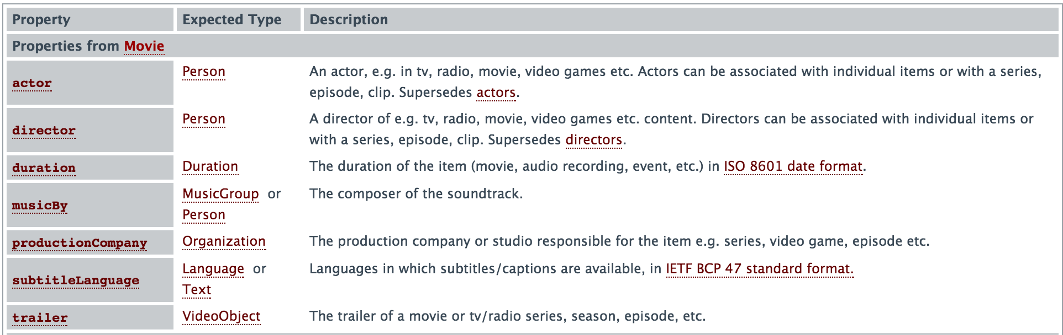
Example: Ontology
Schema:Movie
Notes:
In computer science and information science, an ontology is a formal naming and definition of the types, properties, and interrelationships of the entities that really or fundamentally exist for a particular domain of discourse. It is thus a practical application of philosophical ontology, with a taxonomy.
This is not a complete list of popular ontologies. We will be focusing on these two.

Slide 34
Publishing semantic data requires Encodings
Standards allow other consumers to understand the semantic data.
RDF
RDFa
JSON-LD

Slide 35
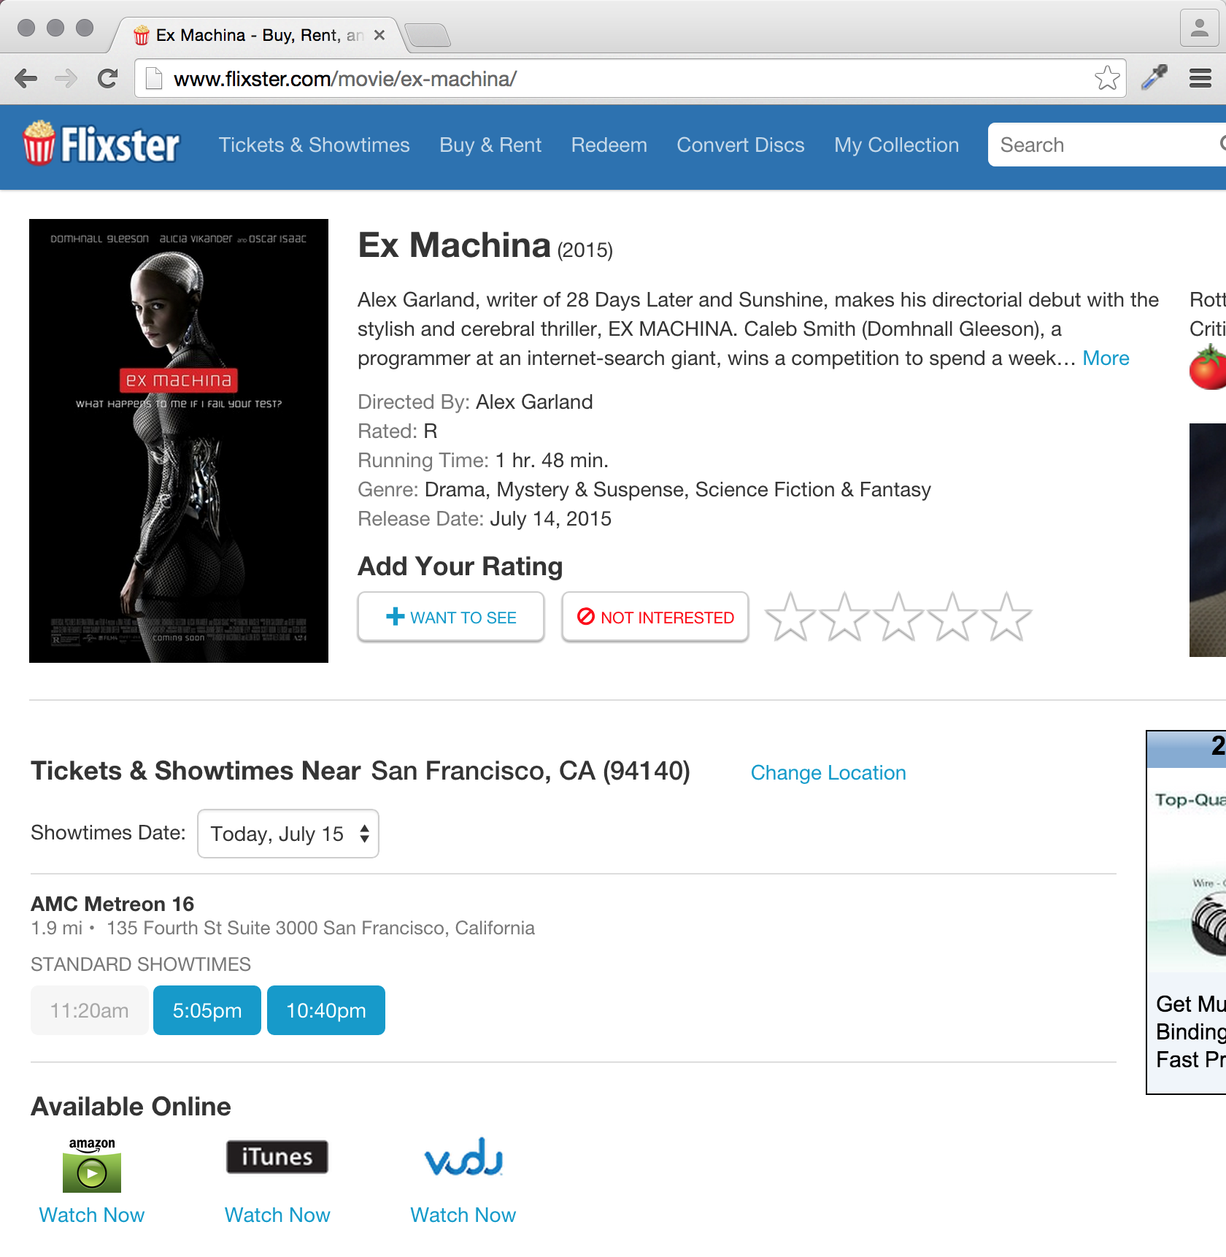
Example: Content Modeling
Flixster encodes content using RDFa according to Schema.org vocabulary.
Type: http://www.schema.org/Movie
ID: /movie/ex-machina/
Other properties from schema:Movie: name, image, etc.
Relationships to other objects: directors, film makers
Nested objects: reviews
Notes:
The ID is very useful for canonicalizing and identifying the state.

Slide 36
Presentation
Cues to 3rd parties about how to present content:
Layout
Important information and less important information
Images and thumbnails
Three common structured data standards for presentation:
Twitter Card layouts
Open Graph types
Schema types

Slide 37
Presentation Examples
Open Graph Types consumed by Facebook
Examples of different layouts: video.movie, music.song, etc.
Schema.org Types consumed by Apple App Search
AggregateRating
Offers
PriceRange
InteractionCount
Organization
Recipe
SearchAction
ImageObject

Slide 38
Relevance
When is a particular deep state or its related content pertinent to a user’s information need?
Descriptions of the actions the app’s state performs.
Semantic content is easier to acquire for faceted or structured data search.
Signals of quality and accuracy

Slide 39
Relevance: Action Modeling
Simplest case: An action is something a user can do to an object.
A few Schema Actions:
ConsumeAction
EatAction
ViewAction
CreateAction
DrawAction
TradeAction
OrderAction

Slide 40
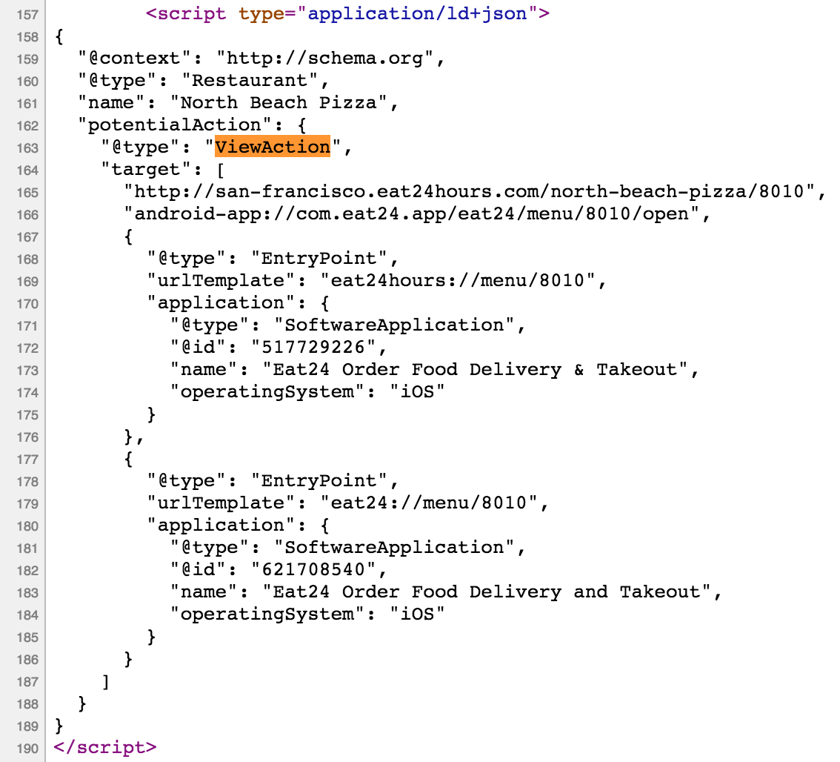
Example: Action Modeling
Google utilizes the ViewAction in the App Indexing standard to show other methods for viewing the current state.

Slide 41
Example: Action Modeling
Intent objects feature a simple, flat list of standard Actions.
Some examples:
ACTION_EDIT
ACTION_SEARCH
ACTION_CALL
ACTION_VIEW

Slide 42
Relevance: Action Modeling
Search products focused on helping users to perform more real-life actions will benefit greatly from developers publishing more semantic data about what actions their apps perform.

Slide 43
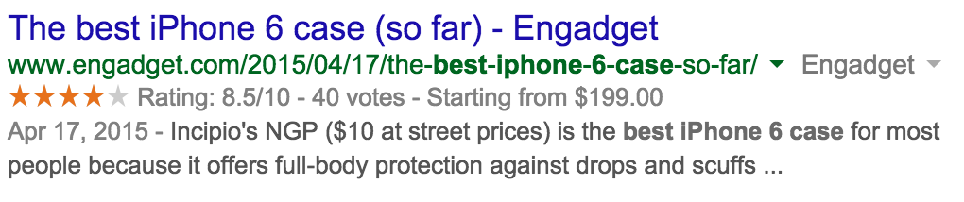
Relevance: Ease of Content Acquisition
Expressing simple types and common properties goes a long way to improving the recall of content in search environments.

Slide 44
Relevance: Quality and Accuracy
Implementing structured data correctly is publically listed by Apple as a positive ranking feature for App Search.
Google published an interesting paper on Knowledge-based trust:
“The quality of web sources has been traditionally evaluated using exogenous signals such as the hyperlink structure of the graph. We propose a new approach that relies on endogenous signals, namely, the correctness of factual information provided by the source. A source that has few false facts is considered to be trustworthy. “

Slide 45
Describing Content and App Behavior leads to better UX
Effective Deep Linking with semantic data helps other apps identify states and direct users to the most relevant states of your App.
Semantic data helps search engines and other products know more about your content, how to present it and when it’s relevant to their users.

Slide 46

Please take a moment to fill out the class feedback form via the app.
Paper feedback forms are also available in the back of the room.
eventmobi.com/adcboston

Slide 47
Additional Resources

Slide 48
Tools: Android Asset Packaging Tool
Analyze an application
aapt list [-a] file.{zip,jar,apk}

Slide 49
Tools: Example Output
E: activity (line=2023)
A: android:name(0x01010003)="com.yelp.android.ui.activities.ActivityBizUrlCatcher" (Raw: "com.yelp.android.ui.activities.ActivityBizUrlCatcher")
A: android:exported(0x01010010)=(type 0x12)0xffffffff
E: intent-filter (line=2026)
E: data (line=2027)
A: android:scheme(0x01010027)="http" (Raw: "http")
A: android:host(0x01010028)="yelp.com" (Raw: "yelp.com")
A: android:pathPrefix(0x0101002b)="/biz/" (Raw: "/biz/")
Notes:
YONI
This is the example output of the tool, showing Yelp’s links

